Slide 1
Data Link Layer
Data Link Layer Functions
Line Discipline
Error Control
Flow Control

Slide 2
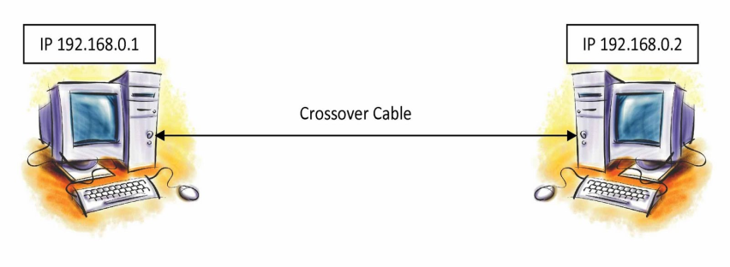
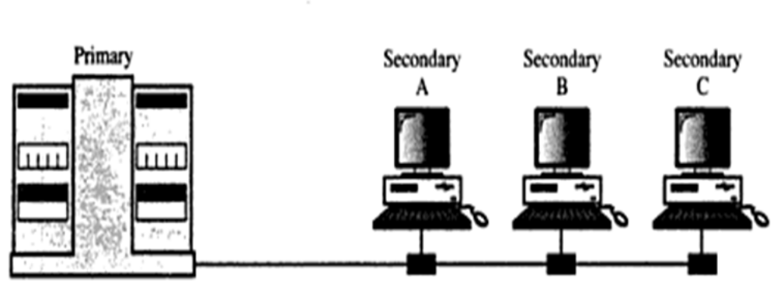
Line Discipline
ENQ/ACK:
Used in peer-to-peer. communication.
SELECT/POLL:
Used in Primary ands Secondary Devices.
Line Discipline
ENQ/ACK
SELECT/POLL

Slide 3
Line Discipline
ENQ (Enquiry)
Used in peer –peer communication
Enquire whether there is a required link between two devices
Check whether the intended device is capable to receive
ACK (Acknowledgment)
Used in Primary secondary communication
The intended device will acknowledge about its status to the receiver

Slide 4
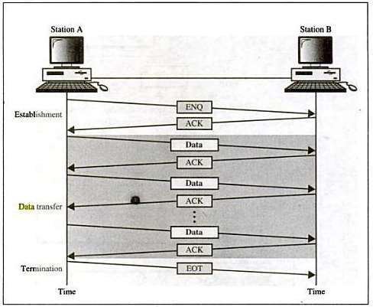
Line Discipline :ENQ/ACK

Slide 5
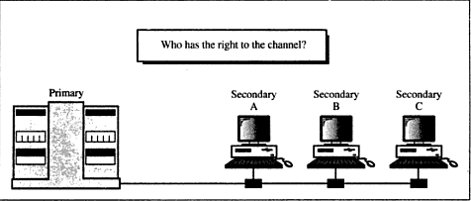
Line Discipline : Select/Poll

Slide 6
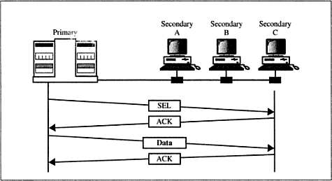
Line Discipline : Select
Select
It is uses whenever the primary device with primary secondary relationship.

Slide 7
Line Discipline : Poll
Poll
The polling function is used by the primary device to Select transmissions from the secondary devices.
If the primary device is ready to receive data , It ask each device in turn if it has anything to send.
.

Slide 8
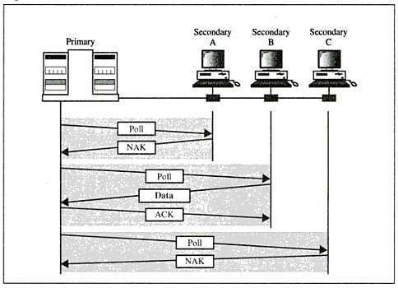
Poll

Slide 9
Flow control
It is a set of procedures to tell the sender how much data it can transmit and wait before receiving the acknowledgement from the receiver.
Flow Control Policies
Stop- and-Wait
Sliding Window
Send one frame at a time
Send several frames at a time

Slide 10
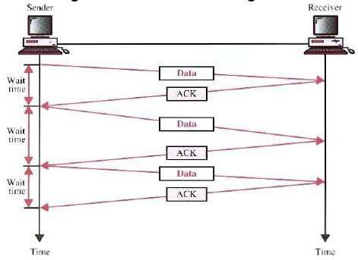
Flow control
Stop-and-wait
Sender sends one frame and waits for an acknowledgement before sending the next frame.

Slide 11
Flow control
Stop-and-wait
Advantages:
Simplicity.
Each frame is checked an acknowledged before the next frame is sent.
Disadvantages:
Slow.
    Can add significantly to the total transmission time if the distance between devices is long.
Inefficiency
    Each frame is alone on the line.

Slide 12
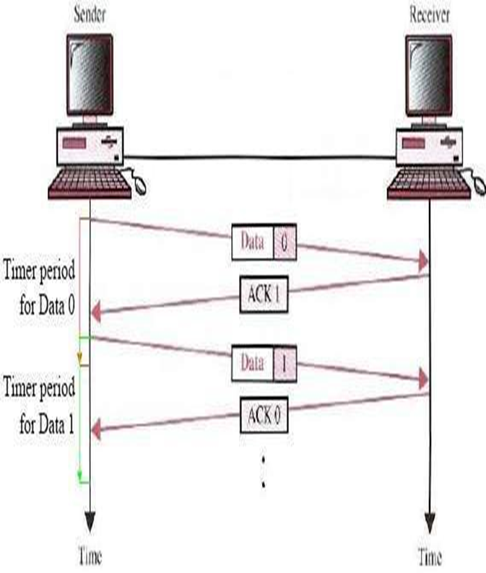
Flow control
Stop-and-wait ARQ
Stop-and-wait ARQ is for data retransmission.
ARQ needs to cater for three possible cases:
Corrupted Frame
Lost Frame
Lost of acknowledgement

Slide 13
Flow control
Stop-and-wait ARQ
Four features added to basic flow control
1.Sender keeps a copy of last transmitted frame until
it receives an acknowledgement.
2.Sending device must equipped with timer
Timer starts every time a frame is transmitted.
If the timer times out and sender has not
received an acknowledgement ,then it assumes
that the frame is lost and retransmission is
required.

Slide 14
Flow control
Stop-and-wait ARQ
3.Numbering of data frame and acknowledgement
frames
allows the receiver to identify duplicate
transmission.
4.Receiving device returns a NAK frame if it detects
an error in a data frame.

Slide 15
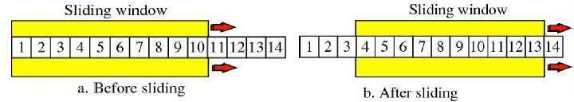
Flow control
SlidingWindow
Sender can send several frames before needing an acknowledgement.
Advantages:
  The link can carry several frames at once.
  Its capacity can be used efficiently.

Slide 16
Flow control
Sliding Window ARQ
It is an extension of sliding window with retransmission
Two options are
1.Go-back-n ARQ
Retransmission of all the frames starting from
corrupted frame
2.Selective-reject ARQ
Retransmission of only corrupted frames.
Stop-and-wait protocol is a special case of sliding- window protocol with a window size of 1.

Slide 17
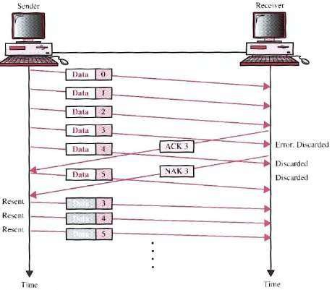
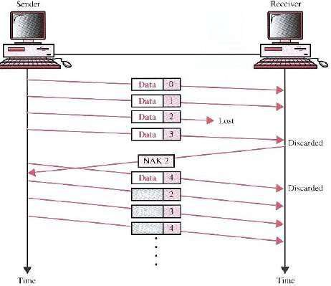

Slide 18
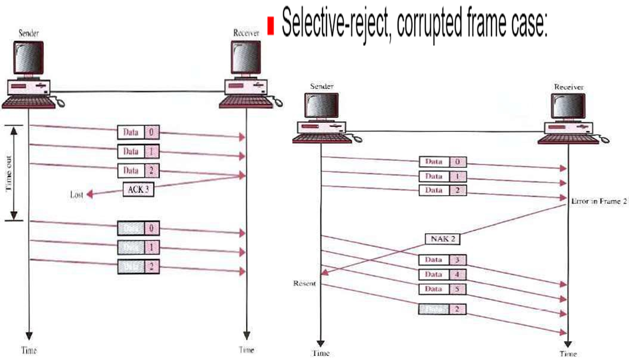

Slide 19
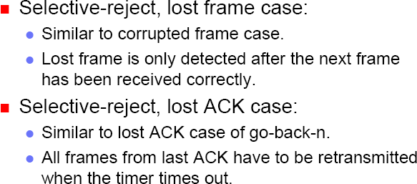
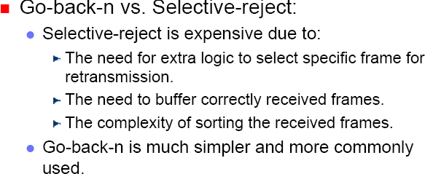

Slide 20
Error Detection and Correction
  Error Detection:
  Allows receiver to detect presence of error
  Error Correction:
  Allows receiver to correct the errors

Slide 21
Basic concepts
Networks must be able to transfer data from one device to another with complete accuracy.
Data can be corrupted during transmission.
For reliable communication, errors must be detected and corrected.
Error detection and correction are implemented either at the data link layer or the transport layer of the OSI model.

Slide 22
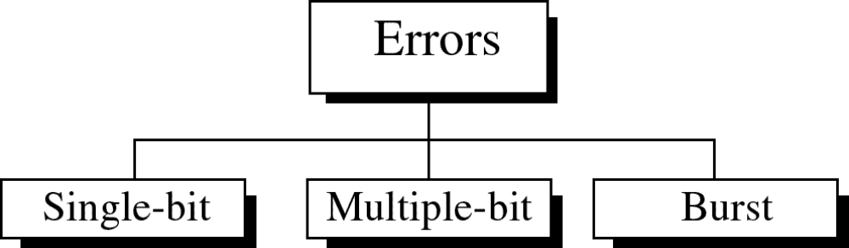
Types of Errors

Slide 23
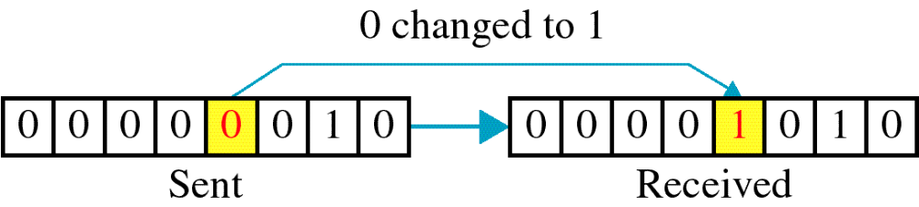
Single-bit error

Slide 24
Single bit errors are the least likely type of errors in serial data transmission because the noise must have a very short duration which is very rare. However this kind of errors can happen in parallel transmission.
Example:
If data is sent at 1Mbps then each bit lasts only 1/1,000,000 sec. or 1 μs.
For a single-bit error to occur, the noise must have a duration of only 1 μs, which is very rare.

Slide 25
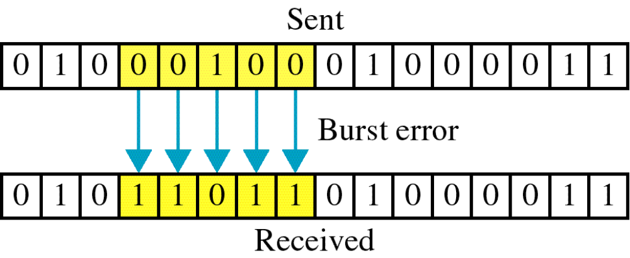
Burst error

Slide 26
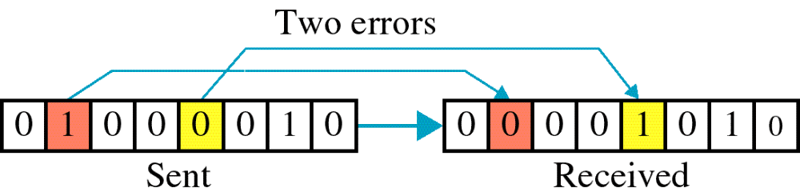

Slide 27
The term burst error means that two or more bits in the data unit have changed from 1 to 0 or from 0 to 1.
Burst errors does not necessarily mean that the errors occur in consecutive bits, the length of the burst is measured from the first corrupted bit to the last corrupted bit. Some bits in between may not have been corrupted.

Slide 28
Burst error is most likely to happen in serial transmission since the duration of noise is normally longer than the duration of a bit.
The number of bits affected depends on the data rate and duration of noise.
Example:
If data is sent at rate = 1Kbps then a noise of 1/100 sec can affect 10 bits.(1/100*1000)
If same data is sent at rate = 1Mbps then a noise of 1/100 sec can affect 10,000 bits.(1/100*10⁶)

Slide 29
Error detection
Error detection means to decide whether the received data is correct or not without having a copy of the original message.
Error detection uses the concept of redundancy, which means adding extra bits for detecting errors at the destination.
Notes:
Make sense of message.
Make sense of message.

Slide 30
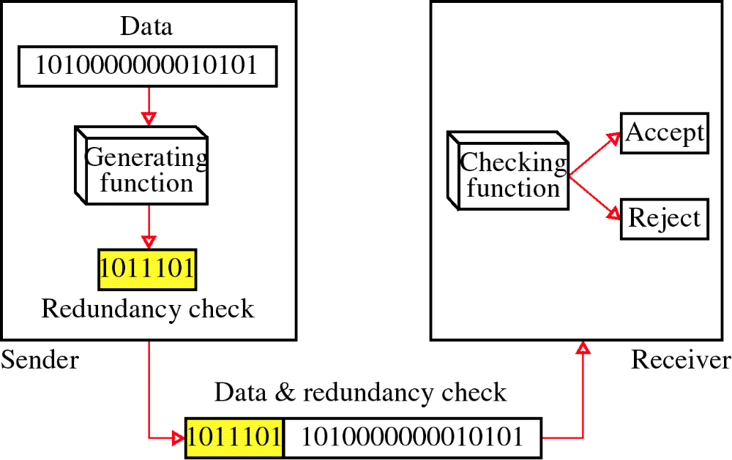
Redundancy

Slide 31
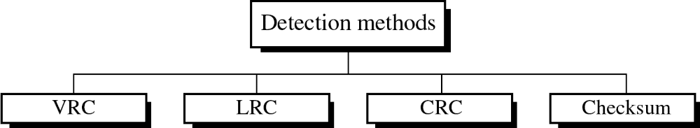
Four types of redundancy checks are used
in data communications

Slide 32
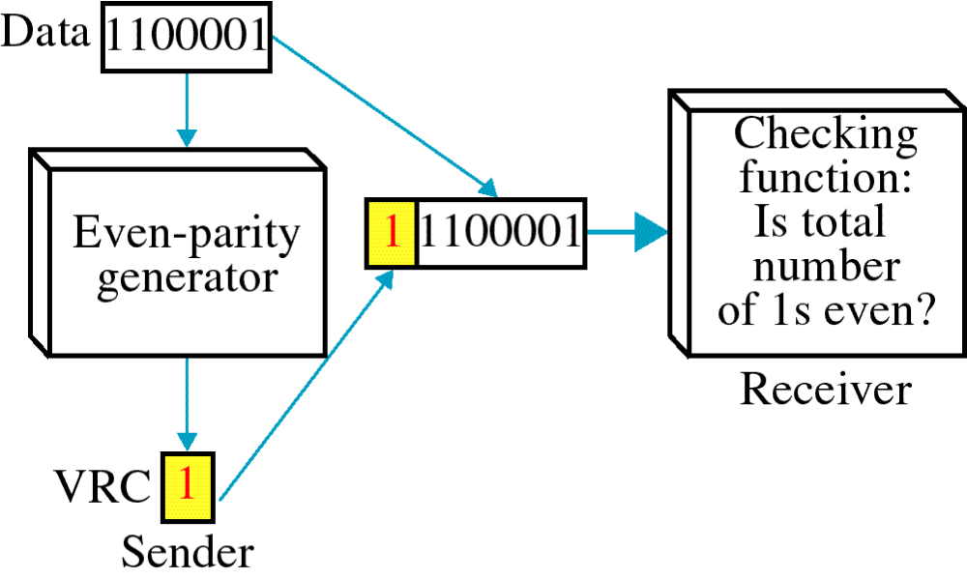
Vertical Redundancy Check
VRC

Slide 33
Vertical Redundancy Check
VRC
The word cute is coded in ASCII as
11000011 1110101 1110100 1100101
c u t e
Using Even Parity checking the sender will send
110000110 11101011 11101000 11001010
If the word is not corrupted during transmission the receiver will count the 1s in each character and comes up with(4,6,4,4) - all even numbers.

Slide 34
Vertical Redundancy Check
VRC
If the word is corrupted during transmission
110010110 11101011 11101000 11000010
If the word is corrupted during transmission the receiver will count the 1s in each character and comes up with(5,6,4,3) - not all even numbers.

Slide 35
Performance
It can detect single bit error
It can detect burst errors only if the total number of errors is odd.

Slide 36
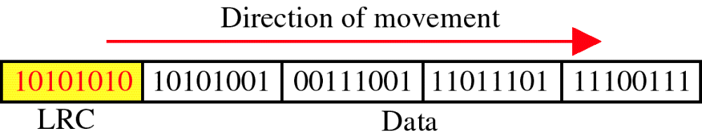
Longitudinal Redundancy Check
LRC

Slide 37
Performance
LCR increases the likelihood of detecting burst errors.
If two bits in one data units are damaged and two bits in exactly the same positions in another data unit are also damaged, the LRC checker will not detect an error.

Slide 38
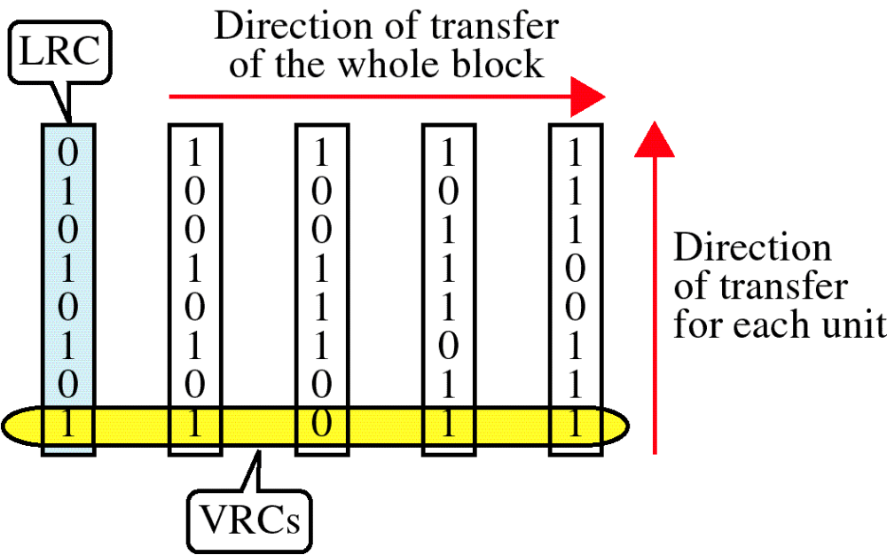
VRC and LRC

Slide 39
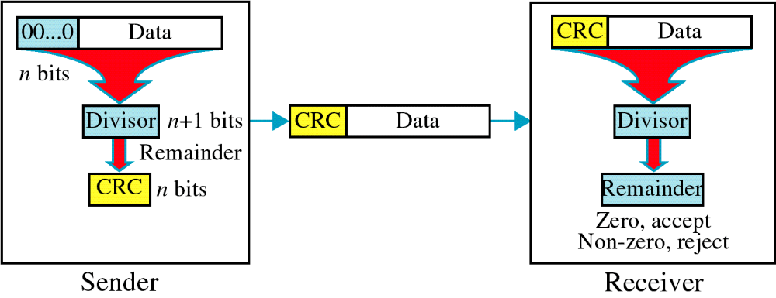
Cyclic Redundancy Check
CRC

Slide 40
Cyclic Redundancy Check
Given a k-bit frame or message, the transmitter generates an n-bit sequence, known as a frame check sequence (FCS), so that the resulting frame, consisting of (k+n) bits, is exactly divisible by some predetermined number.
The receiver then divides the incoming frame by the same number and, if there is no remainder, assumes that there was no error.

Slide 41
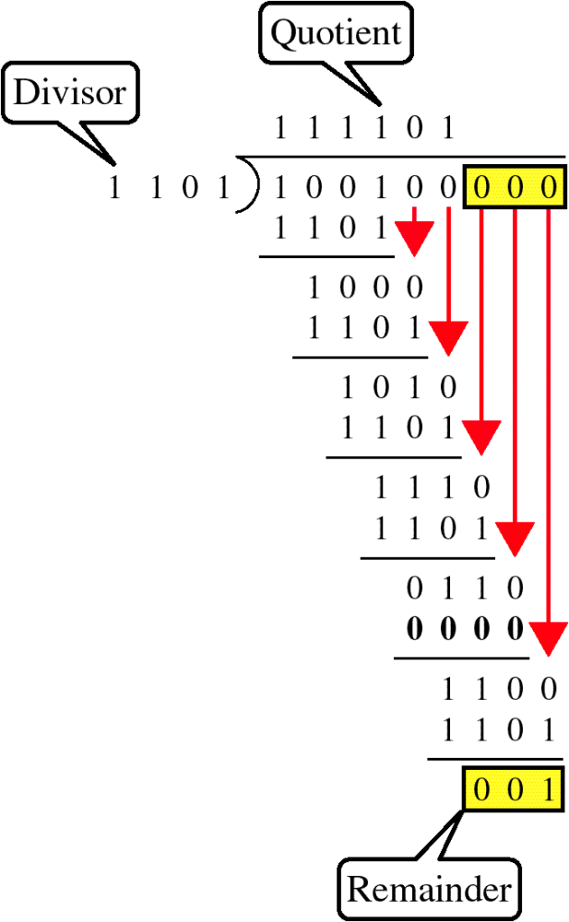
Binary Division

Slide 42
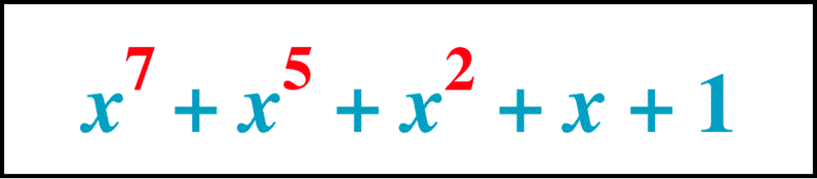
Polynomial

Slide 43
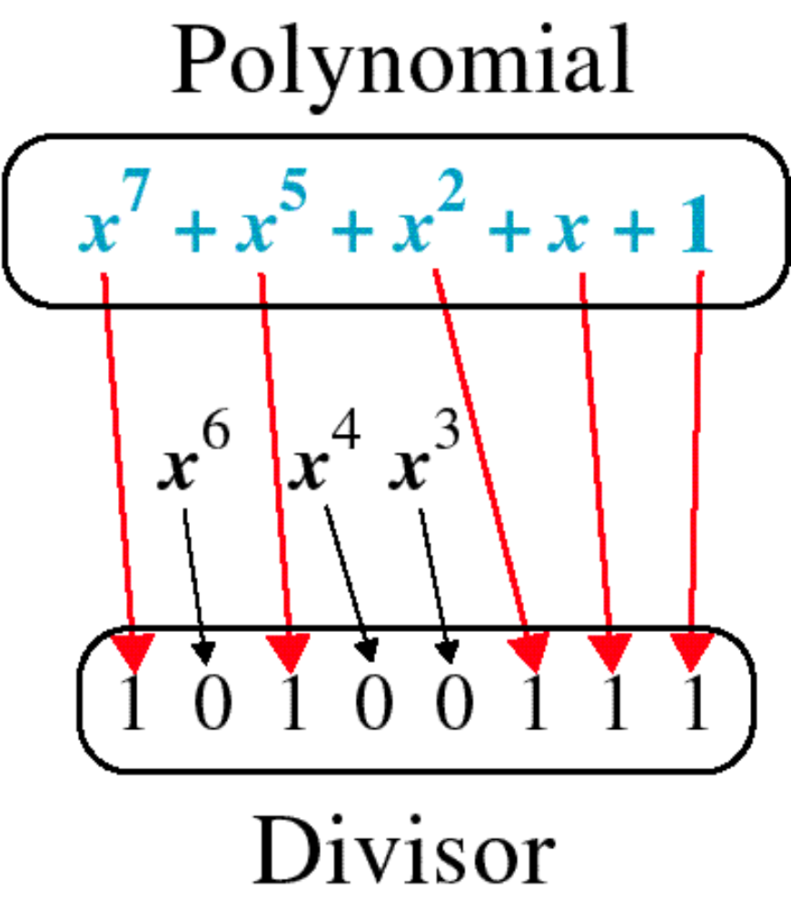
Polynomial and Divisor

Slide 44
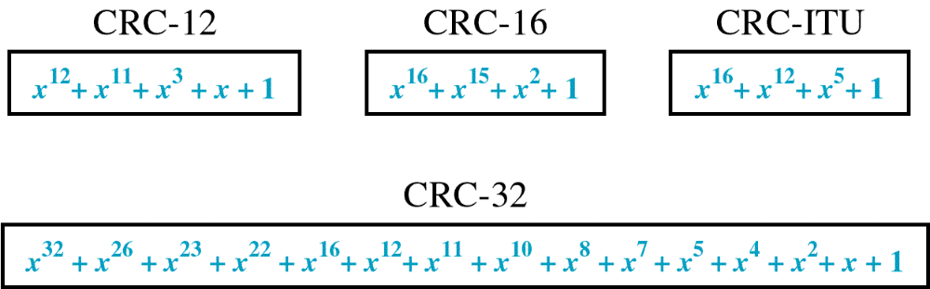
Standard Polynomials

Slide 45
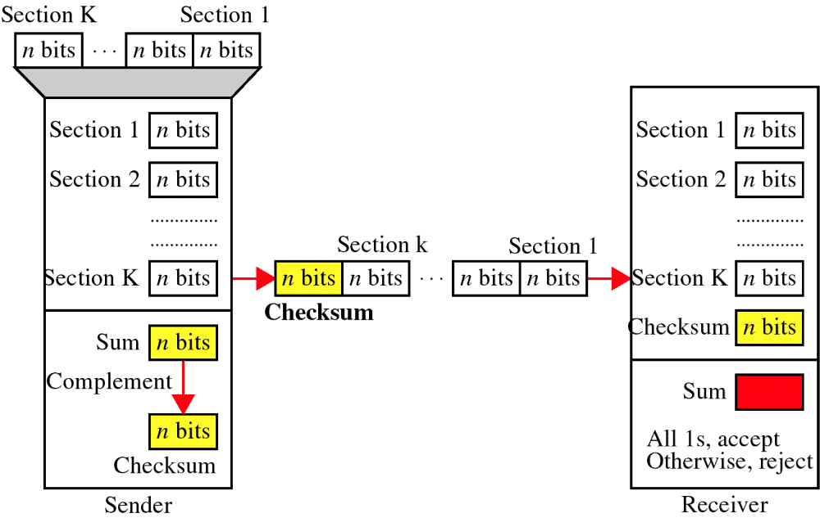
Checksum

Slide 46
At the sender
The unit is divided into k sections, each of n bits.
All sections are added together using one’s complement to get the sum.
The sum is complemented and becomes the checksum.
The checksum is sent with the data

Slide 47
At the receiver
The unit is divided into k sections, each of n bits.
All sections are added together using one’s complement to get the sum.
The sum is complemented.
If the result is zero, the data are accepted: otherwise, they are rejected.

Slide 48
Performance
The checksum detects all errors involving an odd number of bits.
It detects most errors involving an even number of bits.
If one or more bits of a segment are damaged and the corresponding bit or bits of opposite value in a second segment are also damaged, the sums of those columns will not change and the receiver will not detect a problem.

Slide 49
Error Correction
It can be handled in two ways:
receiver can have the sender retransmit the entire data unit.
The receiver can use an error-correcting code, which automatically corrects certain errors.

Slide 50
Single-bit error correction
To correct an error, the receiver reverses the value of the altered bit. To do so, it must know which bit is in error.
Number of redundancy bits needed
Let data bits = m
Redundancy bits = r
∴Total message sent = m+r
The value of r must satisfy the following relation:
2^{r} ≥ m+r+1

Slide 51
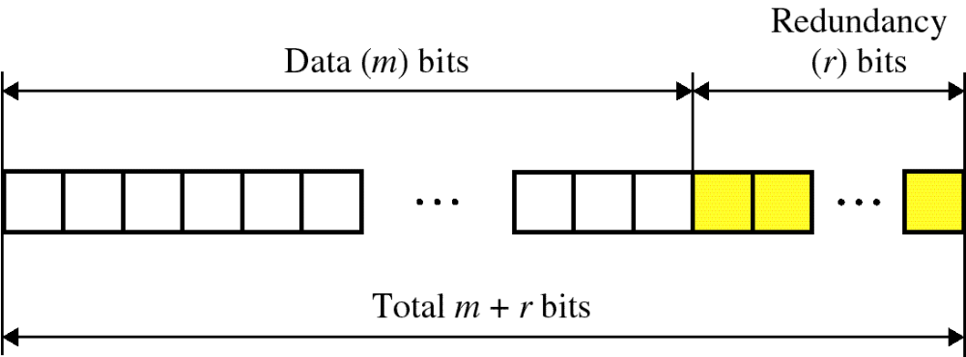
Error Correction

Slide 52
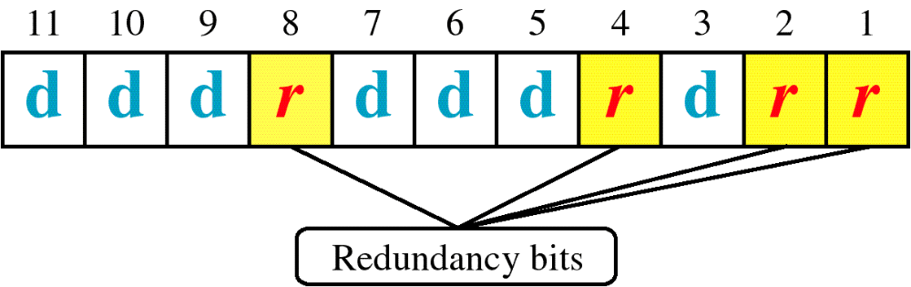
Hamming Code

Slide 53
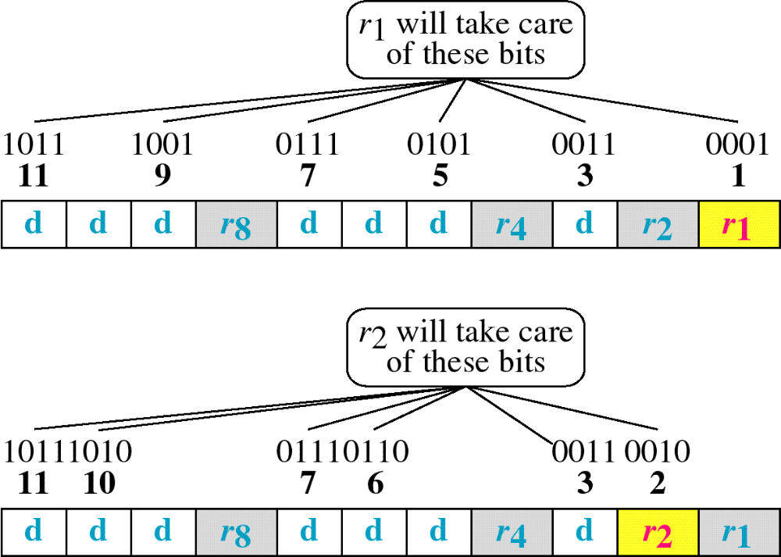
Hamming Code

Slide 54
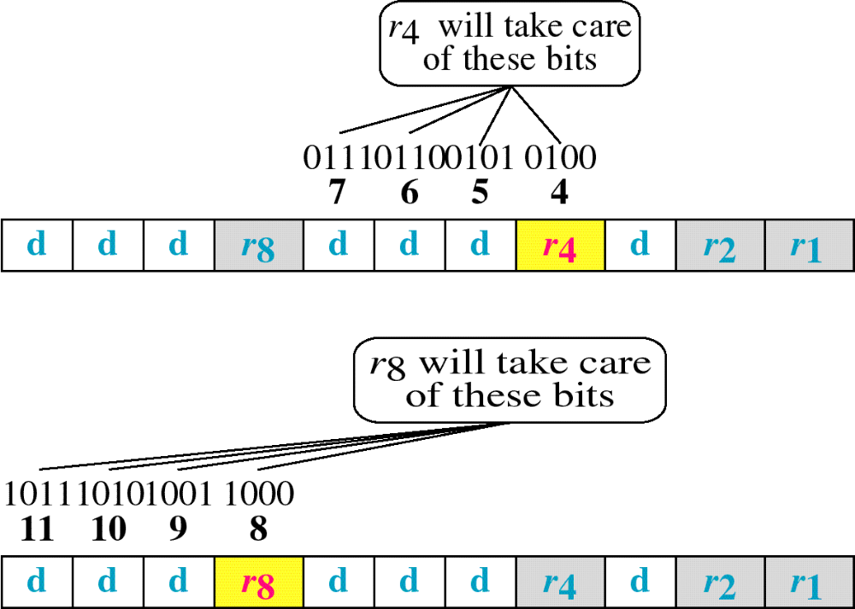
Hamming Code

Slide 55
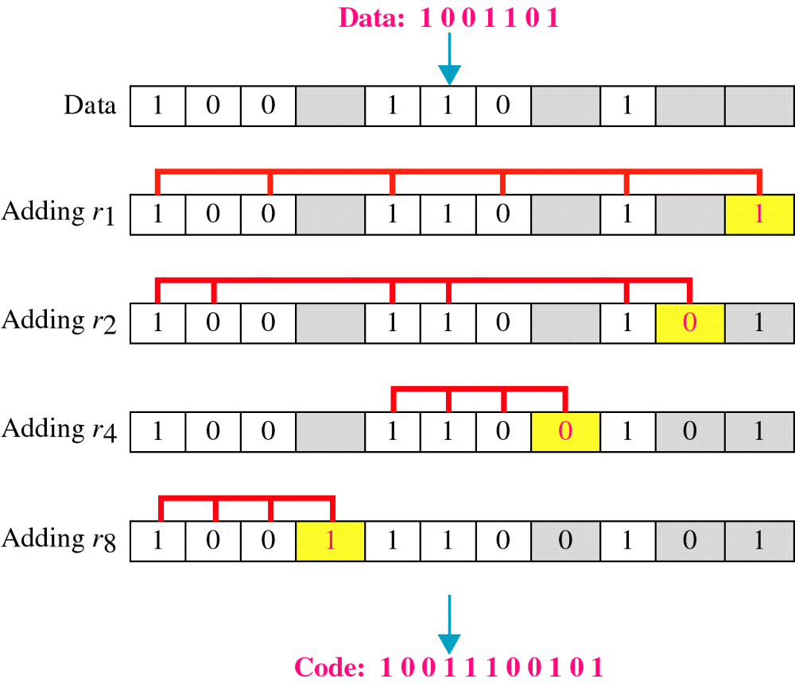
Example of Hamming Code

Slide 56
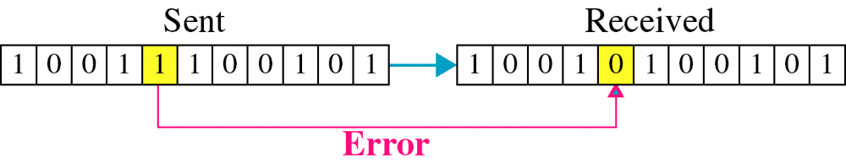
Single-bit error

Slide 57

Error
Detection

